Slide 1
How to Make a Payment or Enter into a Payment Plan
www.manchester.edu

Slide 3
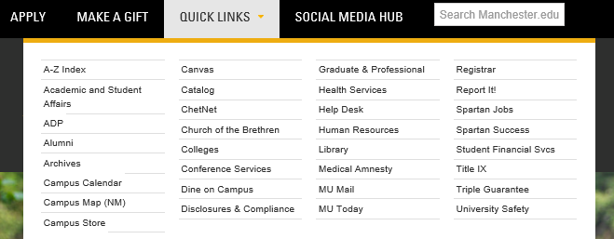
www.manchester.edu

Slide 6
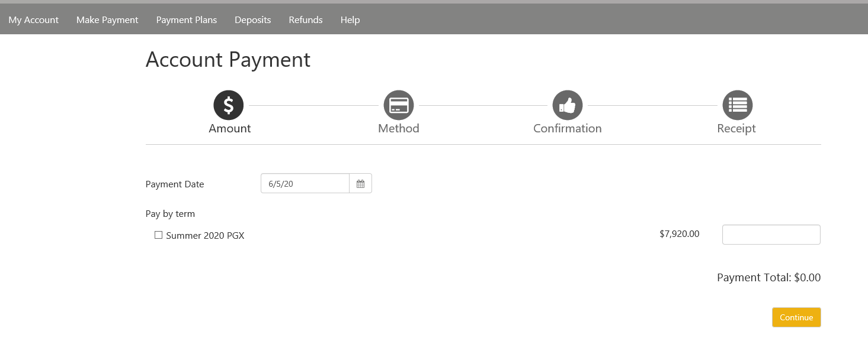

Slide 10
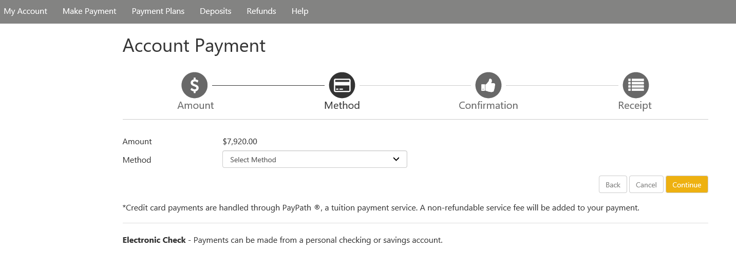

Slide 13
