Slide 1
Inspiring the right mindsets for student success: What faculty can do
Katie Boucher, Ph.D.
University of Indianapolis

Slide 2
When students experience difficulty
Why is this so hard?
But I studied so much for this test!
Why should I try if it won’t matter?
I don’t even know what to do for X.
It’s too late to ask for help or to drop this class.
The professor must think I am not smart, that I don’t care, or that I didn’t try.
I am just not good at X.
Maybe I am not cut out for this major or college.

Slide 3
Undervaluing of effort and perseverance

Slide 4
Differing perceptions and impacts of difficulty
Students from negatively stereotyped, underserved, and/or underrepresented groups experience difficulty more acutely.
Perceived or experienced difficulty can lead to:
Stereotype threat concerns
Belonging concerns
Trust and fairness concerns
These concerns can impair important educational outcomes.
Boucher & Murphy, 2017; Murphy & Taylor, 2012

Slide 5
Mindsets for student success
GROWTH MINDSET
I can improve through effort, strategy, and feedback.
I can trust in this feedback.
This matters.
I matter.
WISE FEEDBACK
PURPOSE MINDSET
BELONGING MINDSET

Slide 6
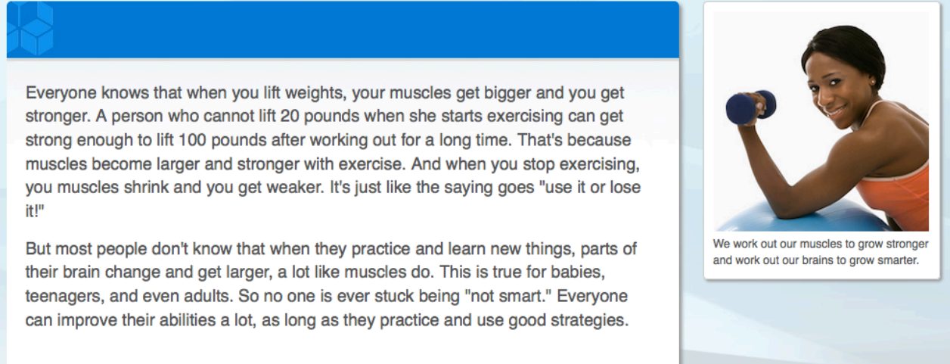
Growth mindset
Share recent research on the malleability of intelligence, provide a description of the growth mindset, and allow students to practice it
Dweck, 2006; Good, Aronson, & Inzlicht, 2003; Yeager, Walton et al., 2016

Slide 7
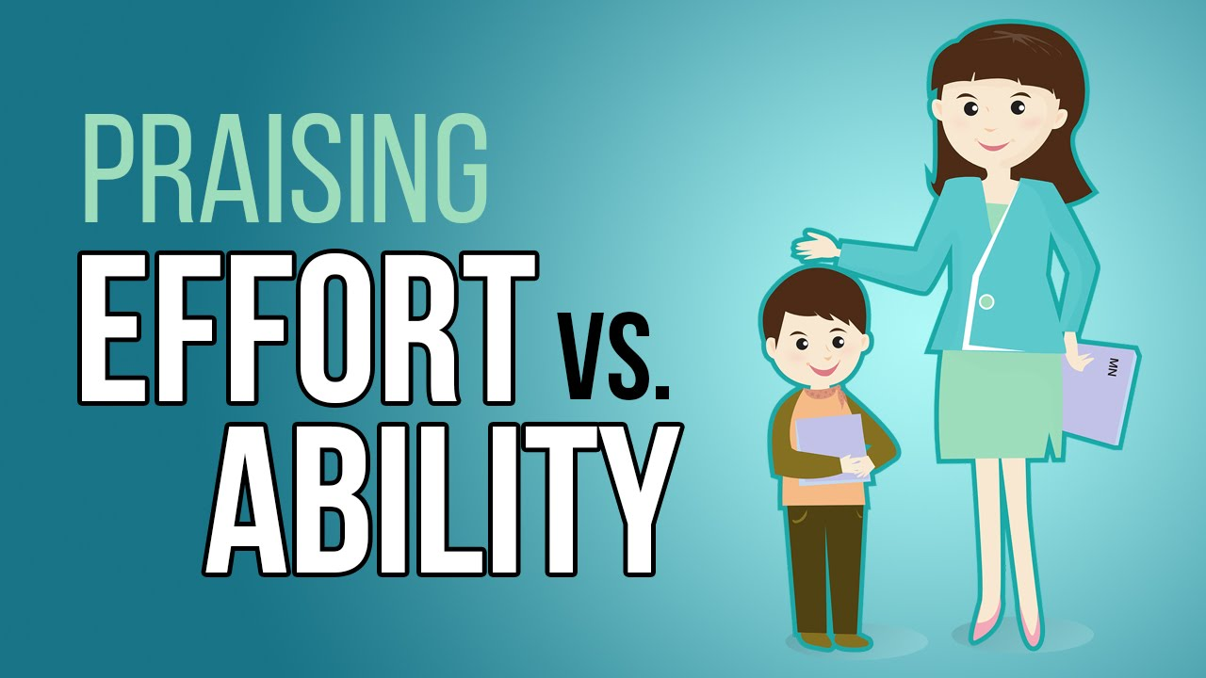
Wise feedback
In feedback to students, communicate that:
You have high standards
You believe that they can meet them
Teach students how to process feedback
“Process praise” over “person praise”
Cohen, Steele, & Ross, 1999; Yeager, Purdie-Vaughns et al., 2014

Slide 8
Purpose mindset
Prompts students to find their own purpose for learning and putting in the effort
Example prompt:
Apply this topic/concept to your life, or to the life of someone you know. How might the information be useful to you, or a friend/relative, in daily life? How does learning about this topic apply to your future plans?
Hulleman & Harackiewicz, 2009; Yeager, Henderson et al., 2014

Slide 9
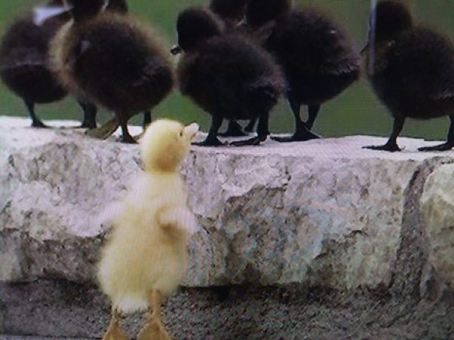
Belonging mindset
Through communications and student narratives provide the following:
Concerns of fitting in socially and academically
Realization that you are not the only one feeling this way
Older students have found their niche
Walton & Cohen, 2007, 2011; Walton, Logel et al., 2015

Slide 10
Evidence of student success
Increase intrinsic motivation, persistence, and openness to feedback
Improved academic outcomes such as grades and retention
Better psychological and physical health outcomes
How do these mindsets work?
Change maladaptive construals of the situation
Allow students to be a part of the change effort
Hook into recursive processes
Walton, 2014; Yeager & Walton, 2011

Slide 11
Tips for a Growth Mindset and Wise Feedback
Syllabus and course structure and policies
Watch your praise and how you talk about difficult material
Practice wise feedback, especially early in the term
Have a threshold for reaching out (C or two absences in quick succession)
Welcome challenge and create the norm that you want mistakes and allow for reflection on them

Slide 12
Tips for a Purpose Mindset
Have them reflect on their purpose before a big assignment or test
Share your narrative (e.g., why you enjoy this part, this task, this field)
Integrate ways in which the knowledge they are gaining can be applied or is relevant to their futures
Have them reflect on their purpose for taking the course at the beginning and end of the term

Slide 13
Tips for a Belonging Mindset
Welcome conversations about accommodations and other student needs
Share your and older students’ experiences
Offer and model proactive coping strategies
Practice how to start and facilitate difficult conversations
Help reframe reactions to poor grades, academic probation, and difficulty with bureaucracy

Slide 14
Questions?

Slide 15
Resources
Project for Education Research That Scales (PERTS), https://www.perts.net/
College Transition Collaborative, http://collegetransitioncollaborative.org/
Press on this work: http://www.nytimes.com/2014/05/18/magazine/who-gets-to-graduate.html?_r=1
http://www.nytimes.com/2016/08/21/opinion/sunday/conquering-the-freshman-fear-of-failure.html

